Slide 1

ALTERNATIVE ROUTE TO CURBING OPIOID CRISIS
Analyzing factors leading to over-prescription of opioid drugs

Slide 2




1
Pratyush Dash
Trishla Mishra
Sai Teja Sagi
Priyabrata Thatoi

Slide 3
OUTLINE
2
DATA DESCRIPTION
BACKGROUND
ANALYSIS
SUMMARY

Slide 4

WHAT IS THE PROBLEM ?

Slide 5

BACKGROUND
4
130
PEOPLE
46
PEOPLE
Die everyday of opioid overdose
Die everyday from overdose
involving opioids prescriptions
Background
Data Description
Analysis
Summary
Source – www.cdc.gov

Slide 6



CONVENTIONAL APPROACH
5
Addiction treatment
Identifying risky patients
Social and economic costs associated
May induce moral hazard
Background
Data Description
Analysis
Summary

Slide 7
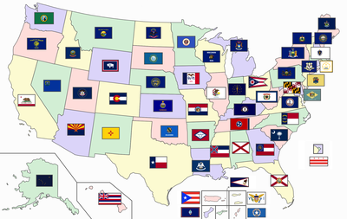


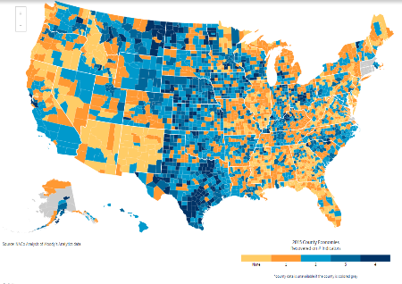
OUR APPROACH
6
High prescription rate
STATE
PROVIDER
Low prescription rate
Identifying doctors that
over-prescribe opioids
COUNTY
Background
Data Description
Analysis
Summary

Slide 8





STAKEHOLDERS
7
Background
Data Description
Analysis
Summary

Slide 9






DATA DESCRIPTION
8
20 Schedule II and III drugs related policies
38 - Health Insurance Coverage , Below Poverty level families, Education, Household units, Median income
21 – Age, Risk score, Race distribution, beneficiary count, Total claims, Total Drug cost, Gender, Specialty
Source : NAMSDL
Source : AmericanFactFinder
Source : www.cms.gov
Background
Data Description
Analysis
Summary

Slide 10
STATE LEVEL ANALYSIS

Slide 11
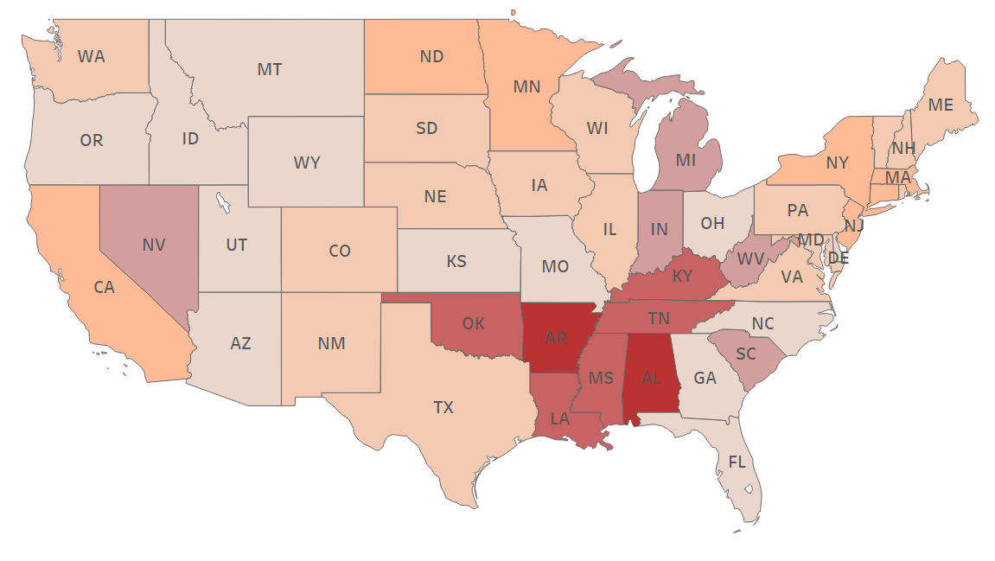
STATE-WISE PRESCRIPTION RATE PER 100 PEOPLE
10
37
108
Background
Data Description
Analysis
Summary

Slide 12
STATE POLICIES IMPACTING PRESCRIPTION RATE
11
Dataset with state policies on opioids
Opioid prescription rate per 100
Regression model
Significant variables
Background
Data Description
Analysis
Summary

Slide 13
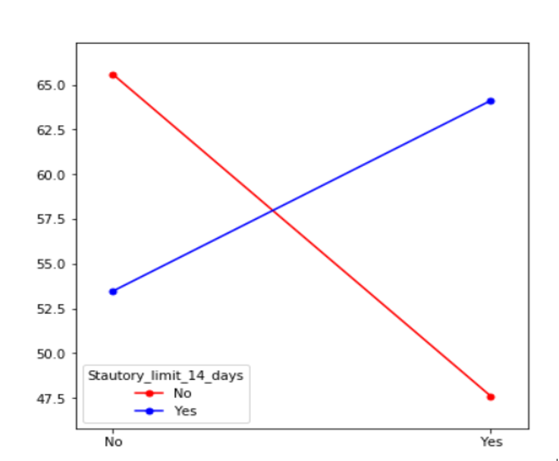
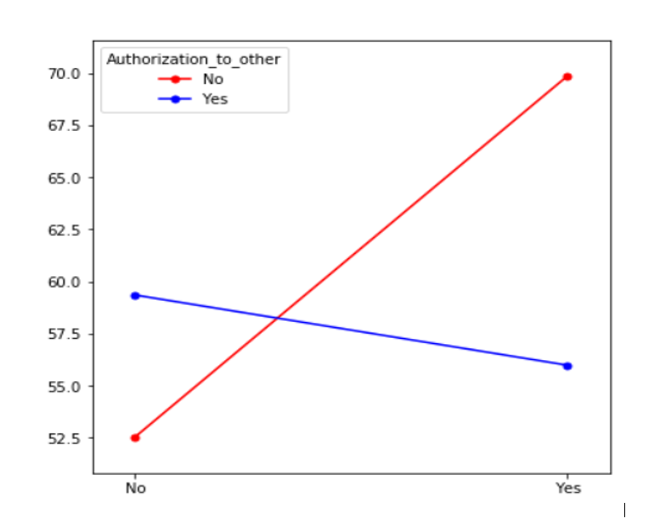


IMPORTANT VARIABLES
12
Average prescription rate
Average prescription rate
Regulate pain management
Written treatment plan
Regulating pain management facilities
Statutory limit for 14 days
Written treatment plan for prescription
Authorization to others
Background
Data Description
Analysis
Summary

Slide 14
COUNTY LEVEL ANALYSIS

Slide 15
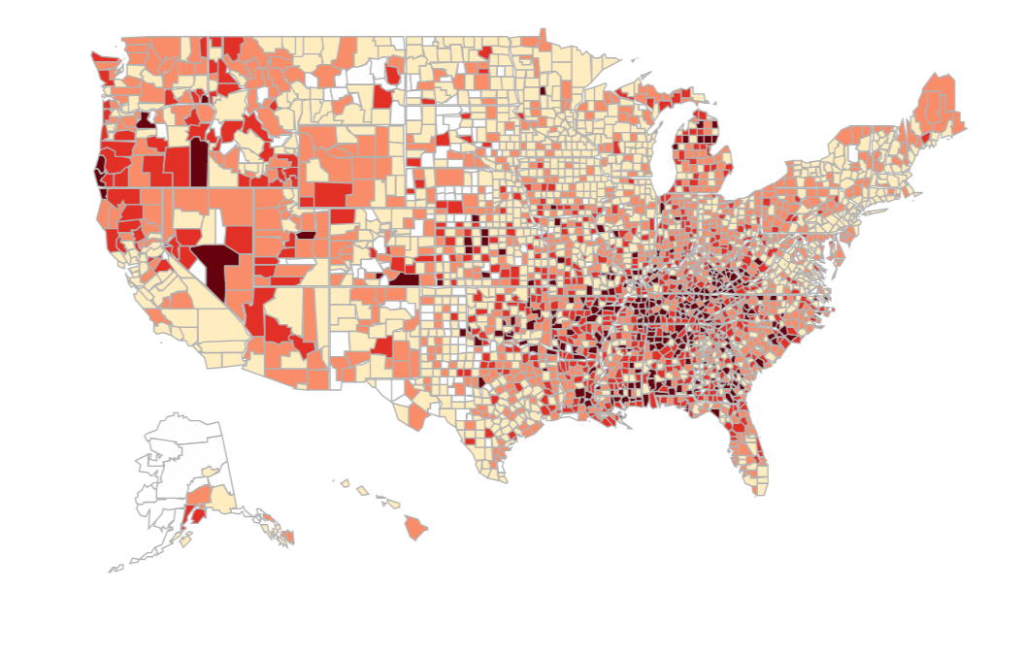
COUNTY-WISE PRESCRIPTION RATE PER 100 PEOPLE
14
LE 57.2
GE 112.5
Background
Data Description
Analysis
Summary
Source – www.cdc.gov

Slide 16
COUNTY-LEVEL FACTORS IMPACTING PRESCRIPTION RATE
15
Dataset with socio-economic parameters on county-level
Opioid prescription rate per 100
Regression model
Significant variables
Background
Data Description
Analysis
Summary

Slide 17




COUNTY-LEVEL FACTORS IMPACTING PRESCRIPTION RATE
16
INSURANCE COVERAGE
EDUCATION
HOUSEHOLD INCOME
Background
Data Description
Analysis
Summary

Slide 18
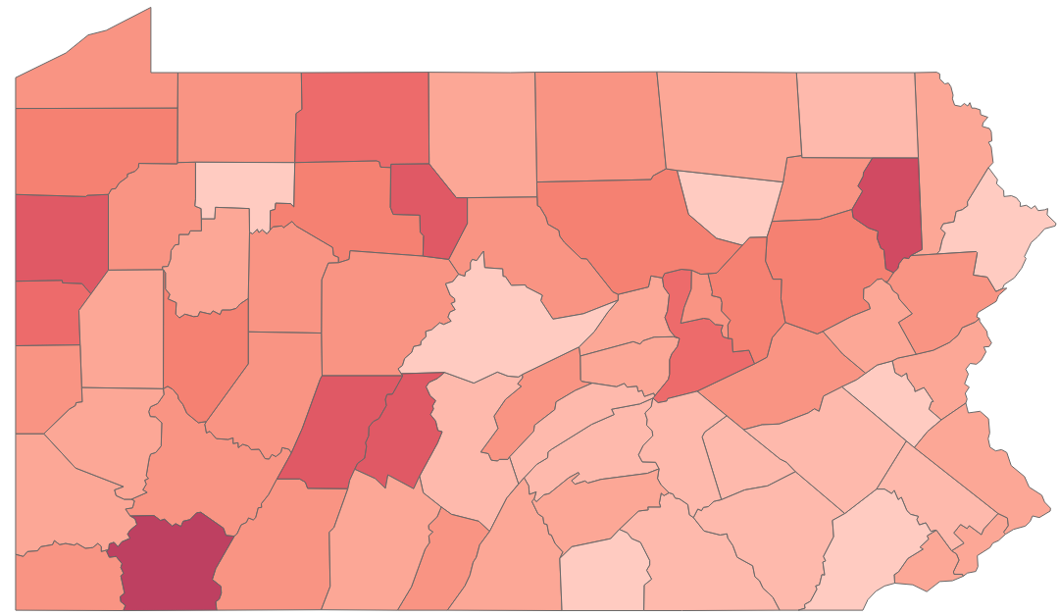
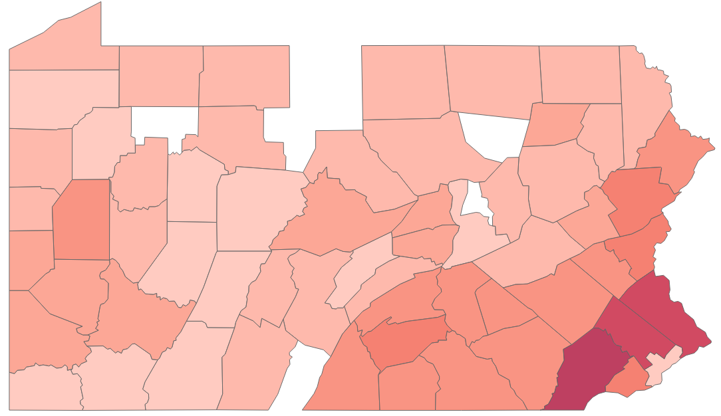
COUNTY-LEVEL FACTORS IMPACTING PRESCRIPTION RATE
17
PENNSYLVANIA COUNTIES
OPIOID PRESCRIPTION RATE
MEDIAN INCOME
Low
High
Counties with lower median income have higher prescription rate
Background
Data Description
Analysis
Summary

Slide 19
PROVIDER LEVEL ANALYSIS

Slide 20
ANALYZING OVER-PRESCRIBERS
19
CMS
STATE
POLICY
COUNTY
FACTOR
COUNTY
STATE
FINAL DATASET
Background
Data Description
Analysis
Summary

Slide 21



TARGET VARIABLE – PRESCRIPTION RATE
20
OVER-PRESCRIBER
(BINARY)
STATE (50)
SPECIALTY (10)
PRESCRIPTION RATE
TOP 10
PERCENTILE
1
TOTAL NO. OF RECORDS – 788,000
EVENT RATE – 4% (32,000)
Background
Data Description
Analysis
Summary

Slide 22

MODEL ANALYSIS
21
DATA ENGINEERING
OVER
SAMPLING
CLASSIFICATION
MODEL
MODEL
COMPARISON
Background
Data Description
Analysis
Summary

Slide 23
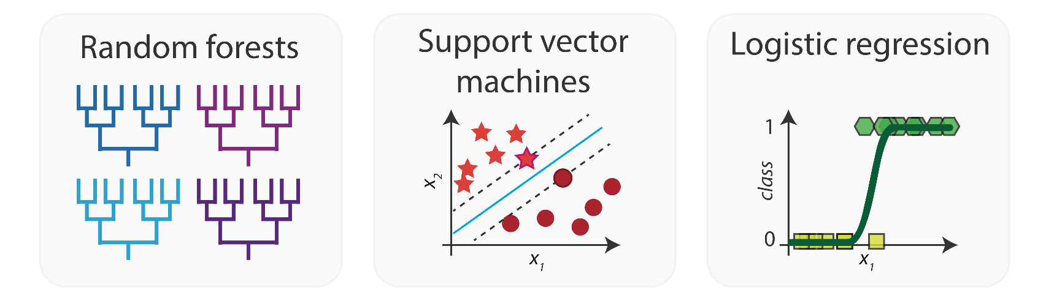

MODEL COMPARISON - ACCURACY
22
81%
Random Forest
69%
Decision Tree
65%
Logistic Regression
Background
Data Description
Analysis
Summary

Slide 24
IMPACT ANALYSIS

Slide 25
STATE FACTORS
24
EFFECT
STATE OPIOID POLICIES
Regulate pain management facilities
23% more likely to over prescribe
Limited supply days for schedule III drugs
16% more likely to over prescribe
Limited supply days for schedule II drugs
8% more likely to over prescribe
Background
Data Description
Analysis
Summary

Slide 26



COUNTY FACTORS
25
High school diploma
Unemployment rate
Population
11%
2%
15%
Higher educated population, unemployment rate & population lead to reduction in chances of over prescribing
Background
Data Description
Analysis
Summary

Slide 27


BENEFICIARY FACTORS
26
Age of the beneficiary
Risk score of the beneficiary
9%
22%
Higher age of beneficiary leads to reduction in chances of over prescribing
Higher risk score leads to increase in chances of over prescribing
Background
Data Description
Analysis
Summary

Slide 28

SUMMARY
27
Predicting over-prescribers rather than high-risk patients
Using state and county factors along with provider data
County level socio-economic data such as unemployment rate, median income etc.
Interaction of 4 policies came out to be significant
Beneficiary data such as age and risk score also significant
Background
Data Description
Analysis
Summary

Slide 29


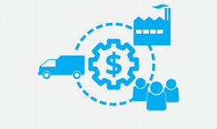
FUTURE STUDY
28
Spatio-temporal analysis of prescription rate
Impact of media on prescription rate
Impact of sales and manufacture on prescription rate
Background
Data Description
Analysis
Summary

Slide 30



Slide 31
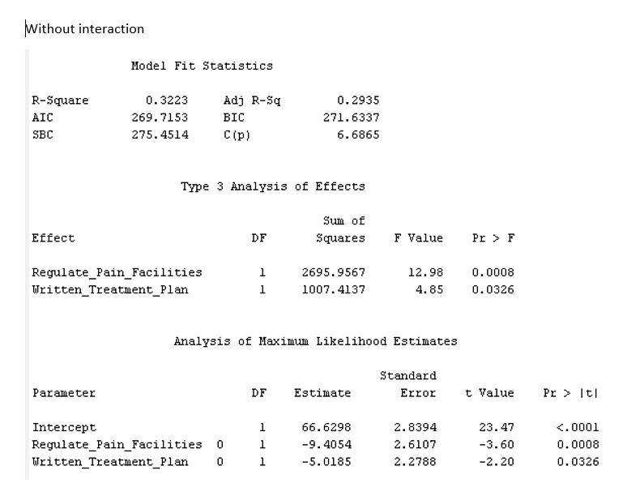
STATE POLICY MODEL

Slide 32
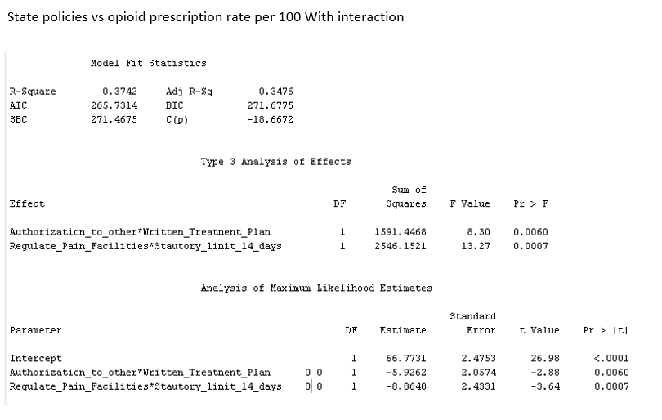
STATE POLICY MODEL

Slide 33
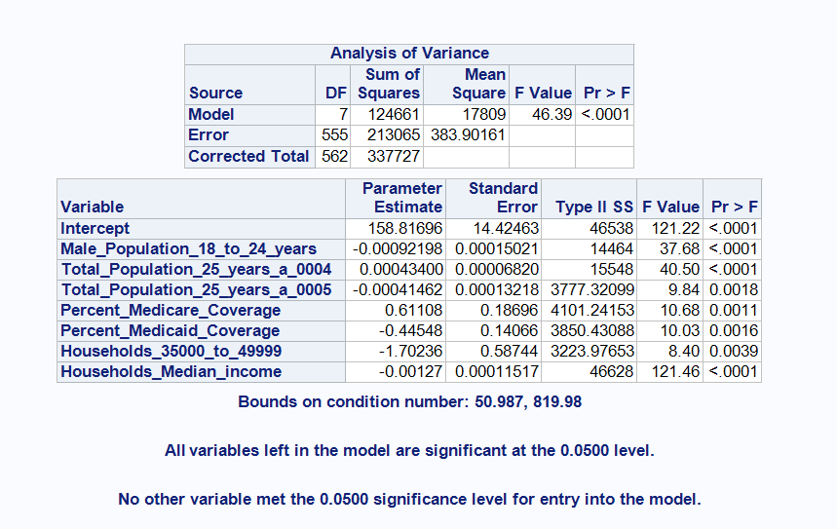
COUNTY MODEL

Slide 34
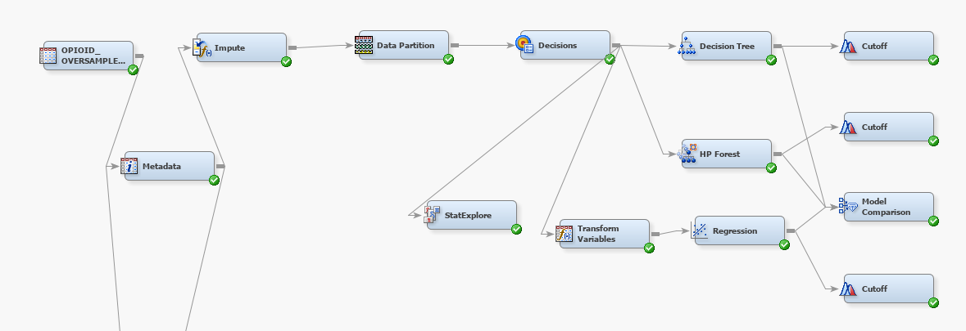
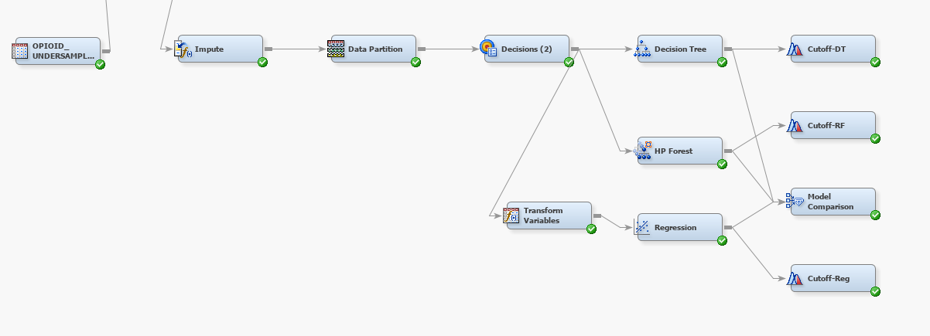
FINAL MODEL

Slide 35
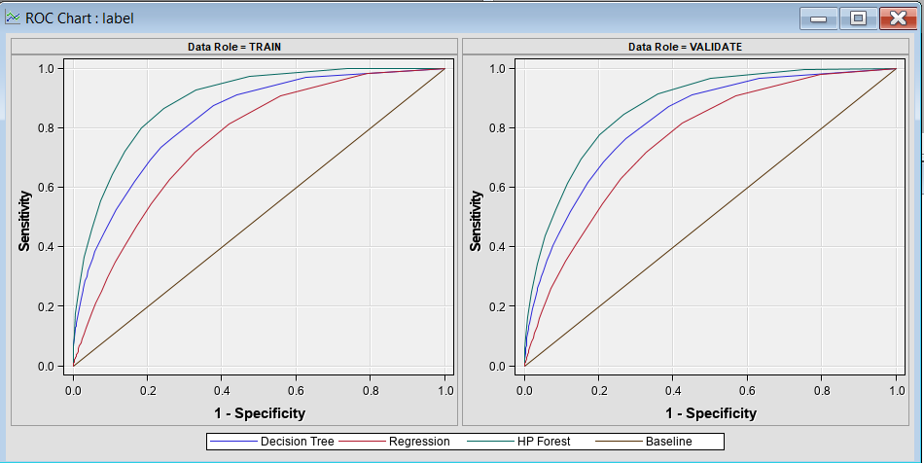
FINAL MODEL - ROC

Slide 36
FINAL MODEL - ROC

Slide 37
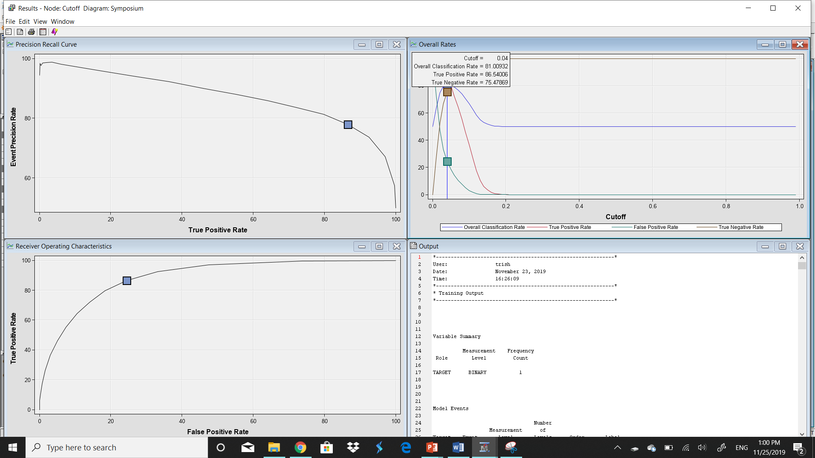
RANDOM FOREST CUTOFF NODE OUTPUT

Slide 38
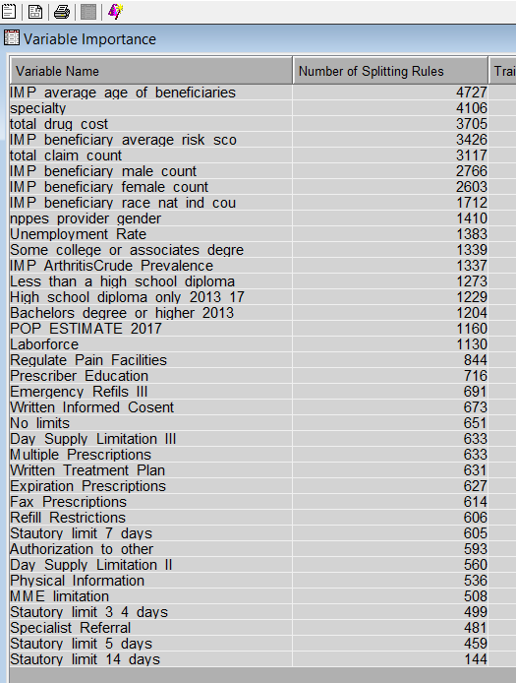
RANDOM FOREST IMPORTANT VARIABLES

Slide 39
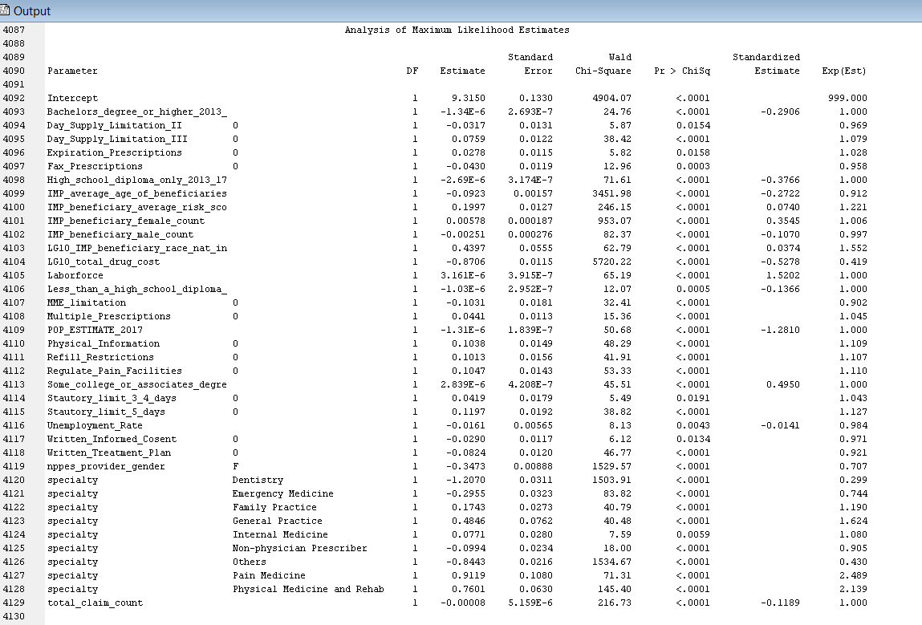
LOGISTIC REGRESSION

Slide 40
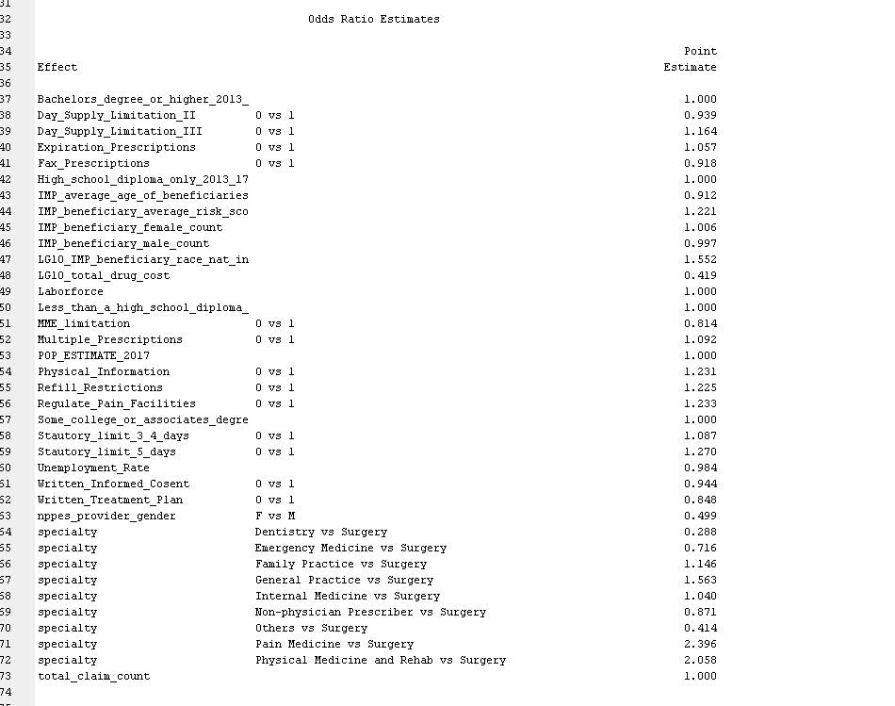
LOGISTIC REGRESSION

